Slide 1
Social Account Password Manager
GROUP MEMBERS:
Muhammad Junaid Saleem (02-131202-057)
Muhammad Amjad (02-131202-041)
Muhammad Ameer Hamza (02-131202-037)

Slide 2
2. GROUP MEMBERS
Muhammad Junaid Saleem
Muhammad Amjad
Muhammad Ameer Hamza

Slide 3
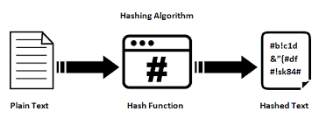
3. ALGORITHM
Hash Algorithm
MD5
SHA-1
SHA-256
Decision Tree(If user forget his password of our password manager Account)

Slide 4
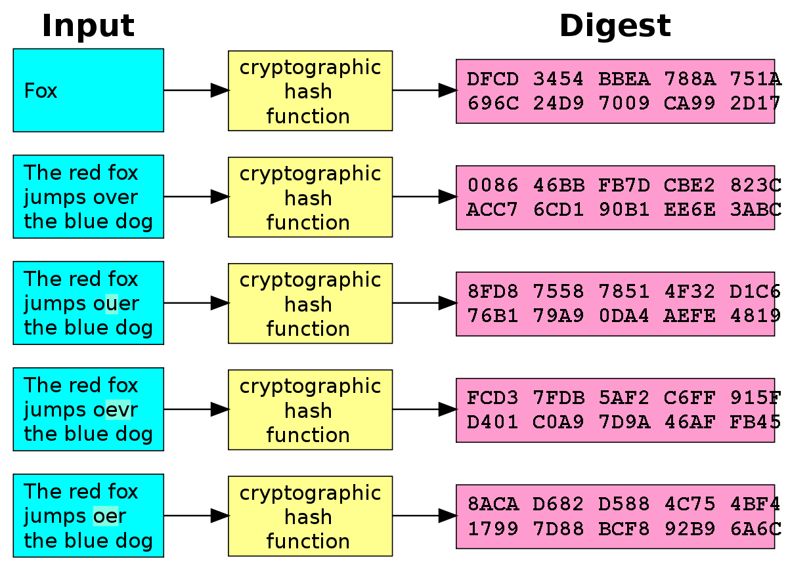

Slide 5
4. WHAT WAS THE PROBLEM
People create their account on Facebook, google, Instagram etc. they all want they should have strong password for their account safety.
They also want that their social account passwords must be saved in their PCs because they want to set different password in different website and it is hard to remember.
People also want to check which encryption is better for their product having login or sign up

Slide 6
5. SOLUTION OF THE PROBLEM
Our software generate strong password with any provided Length which can be easily copied by user and paste on their website.
User also save/create that automatic generated password and store the password he created for account with website url , social platform name and other details like username on their PC. And he can delete also.
Protect User’s Password by using SHA-1, SHA-2 and MD5 Encryption

Slide 7
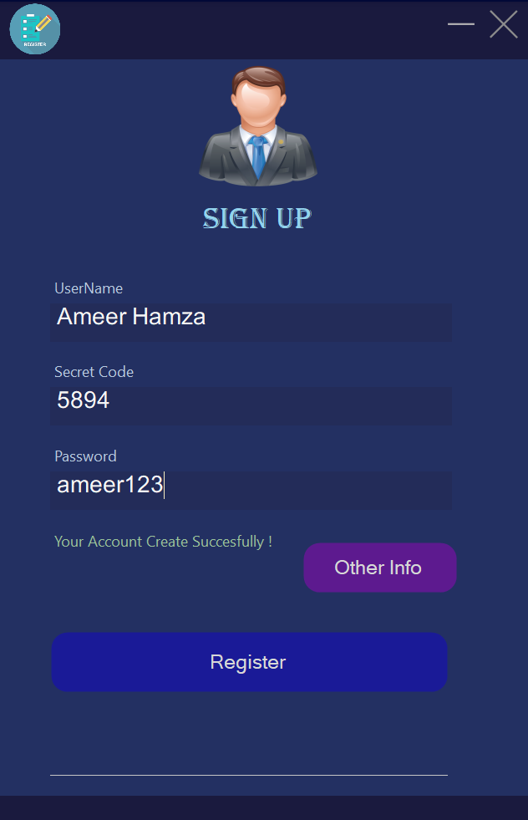
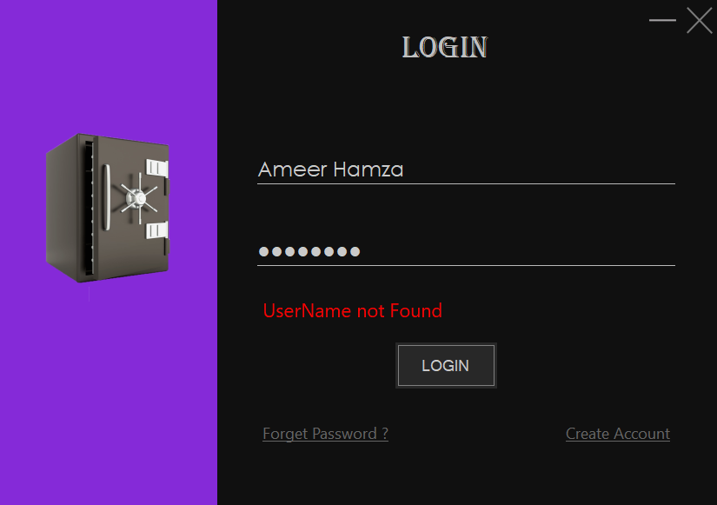
6. PROJECT INTERFACE

Slide 8
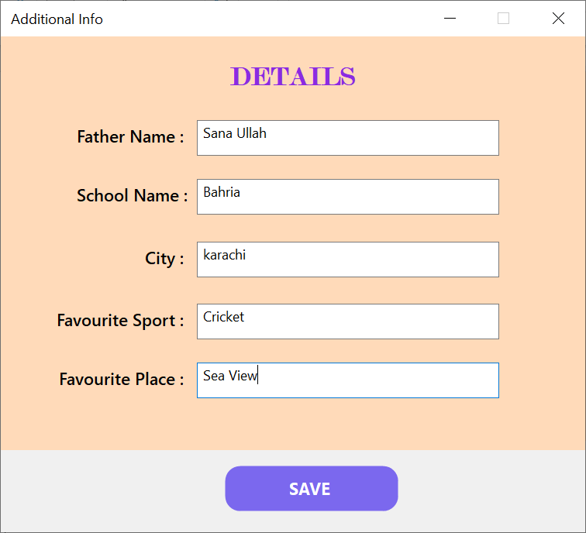
6. PROJECT INTERFACE (Other Detail Form)

Slide 9
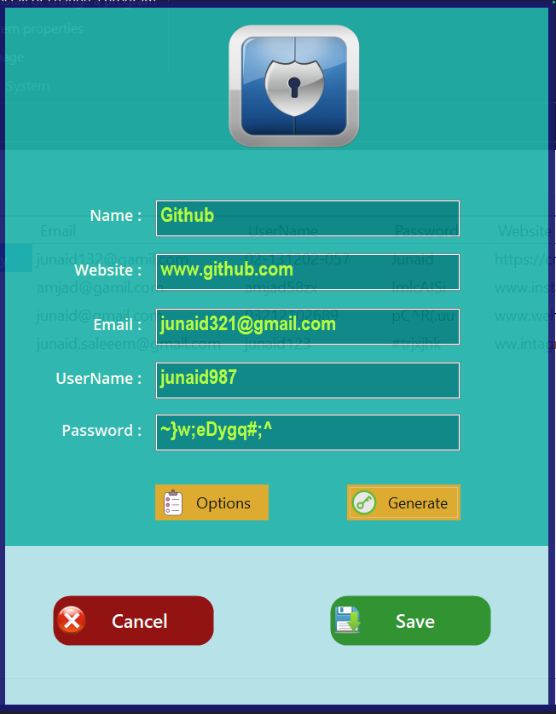
6. PROJECT INTERFACE (New Password Form)

Slide 10
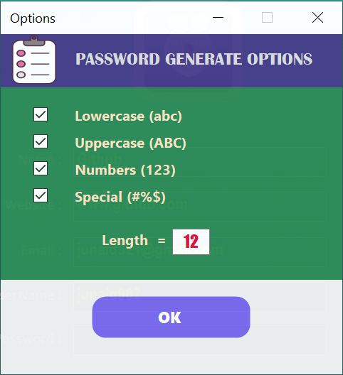
6. PROJECT INTERFACE (Random Password Generate )

Slide 11
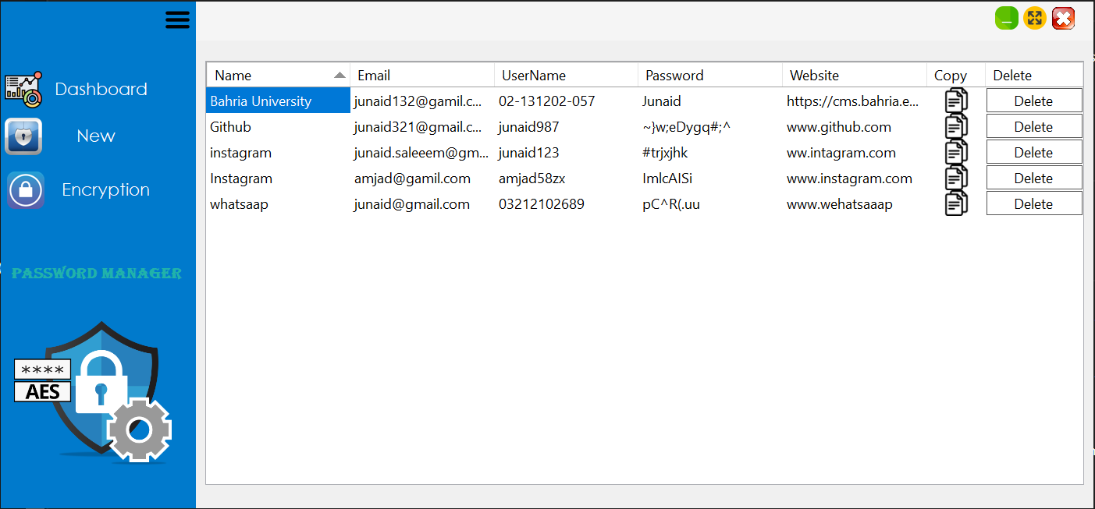
6. PROJECT INTERFACE (DashBoard)

Slide 12
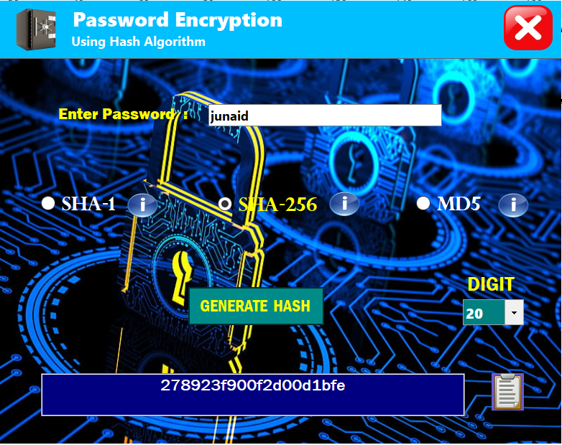
6. PROJECT INTERFACE (Continue)

Slide 13
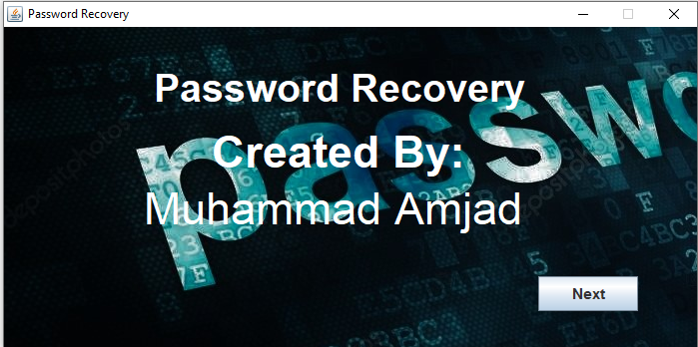
6. PROJECT INTERFACE (Continue)

Slide 14
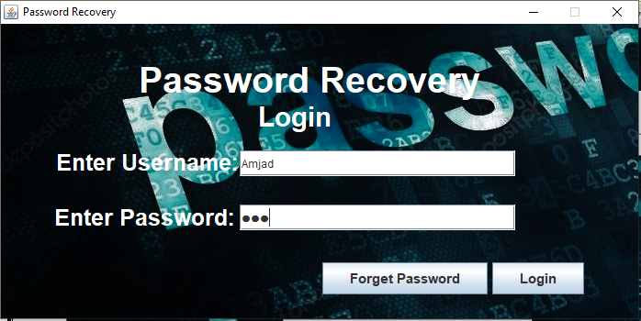
6. PROJECT INTERFACE (Continue)

Slide 15
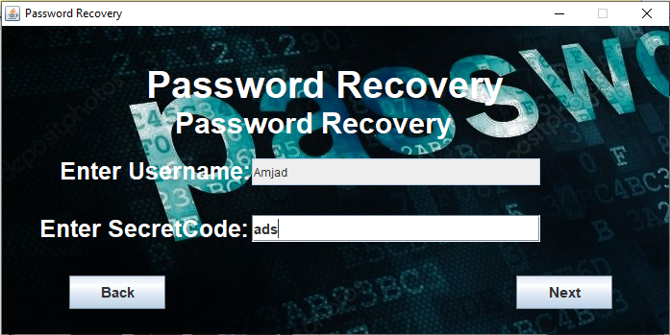
6. PROJECT INTERFACE (Continue)

Slide 16
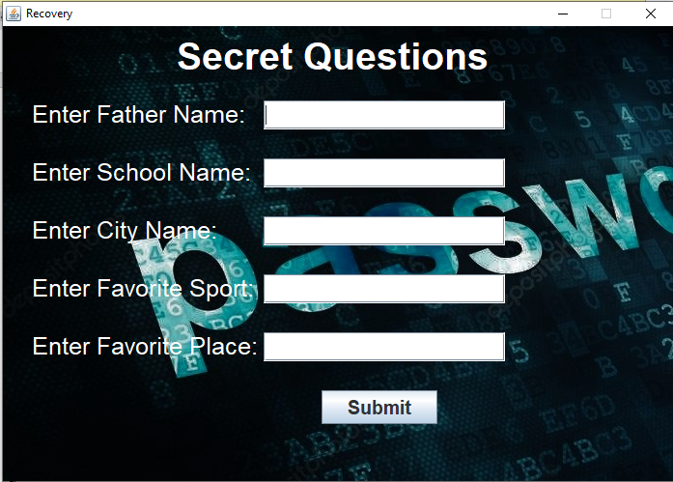
6. PROJECT INTERFACE (Continue)

Slide 17
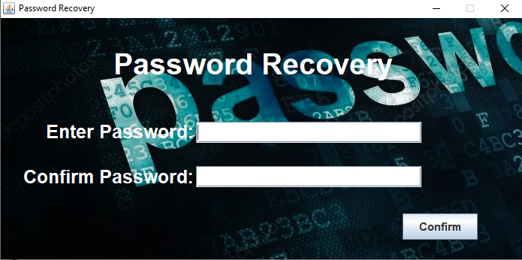
6. PROJECT INTERFACE (Continue)

Slide 18
7. RESPONSIBILITY OF EACH MEMBER IN THE PROJECT
Muhammad Amjad:
Creates GUI of all forms of Forget Password Feature and implemented it by using decision tree on JAVA.
Junaid Saleem Qadri:
Password Encryption form , Random password generate , Hash algorithm , Dashboard form , back-end filing in c#.
Muhammad Ameer Hamza:
SignUp + other details form ,login form ,New Password Form, Main menu form GUI Design in c#

Slide 19
THANKS

